Slide 1
Clocking the Cloud Timing in Datacenters
Bryan Hovey
ITSF 2021

Slide 2
Agenda
Why do Datacenters need precision time?
Example deployment
Making sure it works
calnexsol.com
2

Slide 3
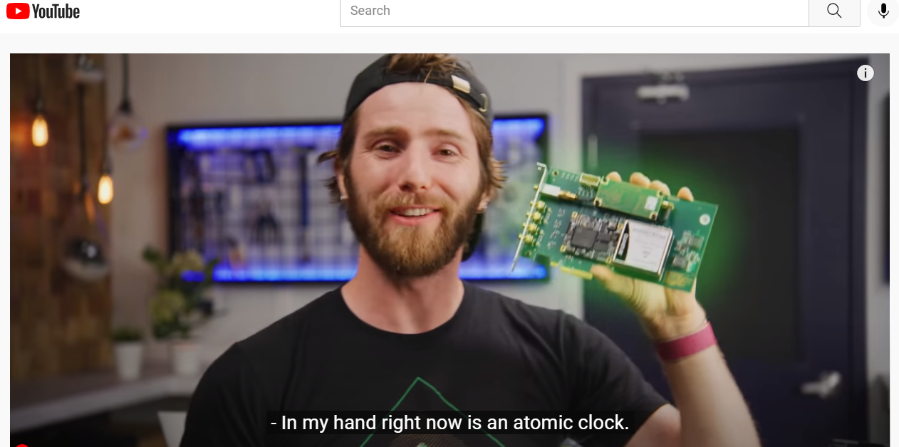
Why do Datacenters need precise time?
Don’t ask me, ask this guy –
https://www.youtube.com/watch?v=JK3eTGkX6qY

Slide 4
Why do Datacenters need precise time?
What ‘this guy’ said (cont’d):
1 computer computes
1 computer computes
2 computers
If all the computers are sync’d, they can compute and make decisions faster
The greater the precision of sync, the faster the decisions can be made
∴ SPEED & CAPACITY
1,000,000 computers

Slide 5
Why do Datacenters need precise time?
What ‘this guy’ said (cont’d):
20ms delay
‘Man-made’ 20ms delay ensures no computer thinks it’s getting data from the future
Precisely sync’d computers mean this 20ms delay can be dropped
1,000,000 computers compute

Slide 6
Why do Datacenters need precise time?
More cool ideas:
Telemetry on a global scale – performance, latency, etc.
Event logging for troubleshooting or optimisation
AI – decision making needs data order integrity (which is first?)
Reduced data exchange (I trust the other computer)
Enable lower spec components?
Q: Who’s driving? A: Cloud
Etc.

Slide 7
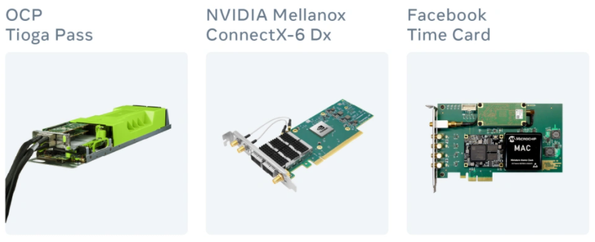
Example deployment
GNSS
Meta
Time Card
Source: Facebook Engineering
Open Compute Project (OCP) Time Card project is an example of delivering microsecond accuracy to any x86 machine with a HW-timestamp enabled NIC via PTP
Other projects also looking at SyncE and White Rabbit in addition to PTP
Datacenter PTP Profile developed within OCP

Slide 8
Datacenter PTP Profile No.1 - OCP
Figure 1.
Model 1 – Chain of
Transparent Clocks
GNSS
Time Reference Layer
GM
TC
Network Fabric Layer
TC
TC
TC
Server Layer
OC
Source: OCP

Slide 9
Why testing/monitoring is required now
Moving from 100ms accuracy to 1µs accuracy – timing and synchronisation becoming more critical for Datacenters
Moving from NTPd to more precise NTP and PTP
For example, from Datacenter PTP Profile No. 1 Model 1 (OCP):
The maximum time error between any two OCs must be within ± 5 µs
The maximum time error between a GM and any OCs must be within ± 2.5 µs
The maximum time error generated by a TC must be within ± 100 ns
Etc.
100ms accuracy didn’t need to be verified. Testing is essential to validate µs accuracy

Slide 10
Example deployment
GNSS
Meta
Time Card
Source: Facebook Engineering
Independent timing monitor for 1PPS, PTP, NTP, SyncE
Automated operation, centralised management
Provides data for pre-emptive or forensic purposes
Timing Monitor

Slide 11
Bryan Hovey
bryan.hovey@calnexsol.com

